Slide 1
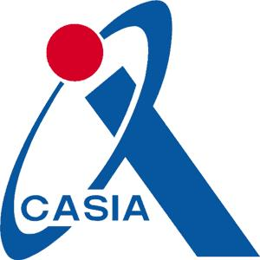
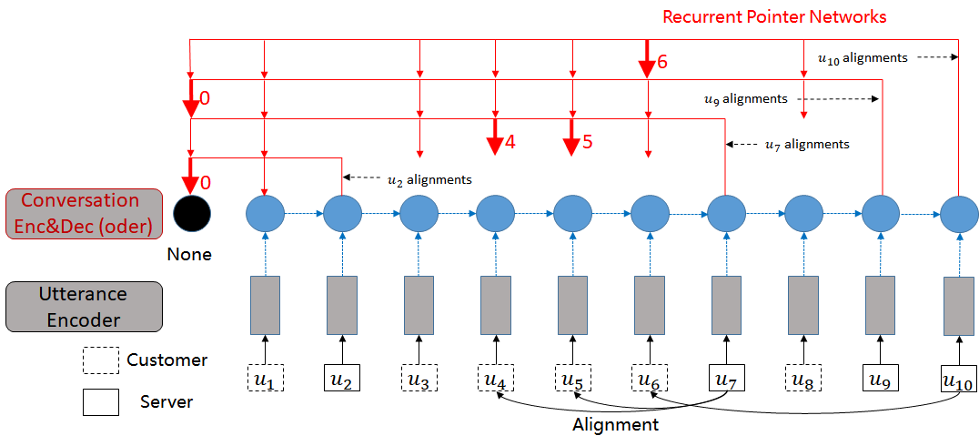
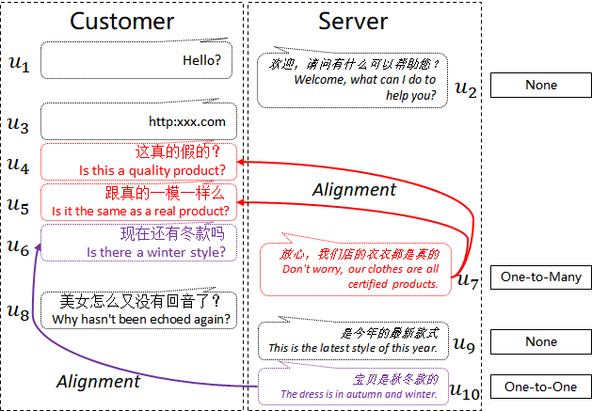
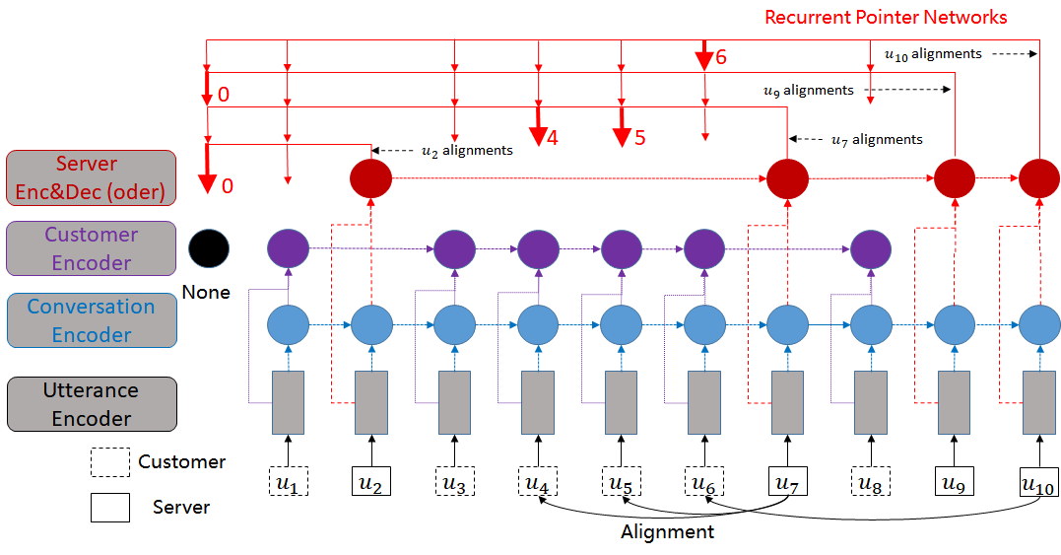



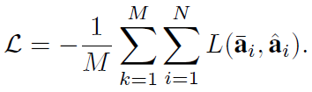


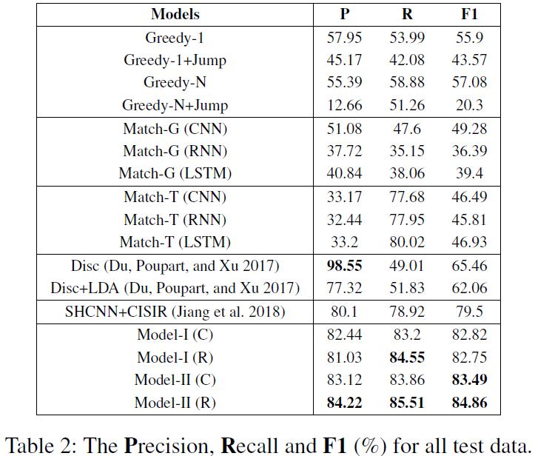
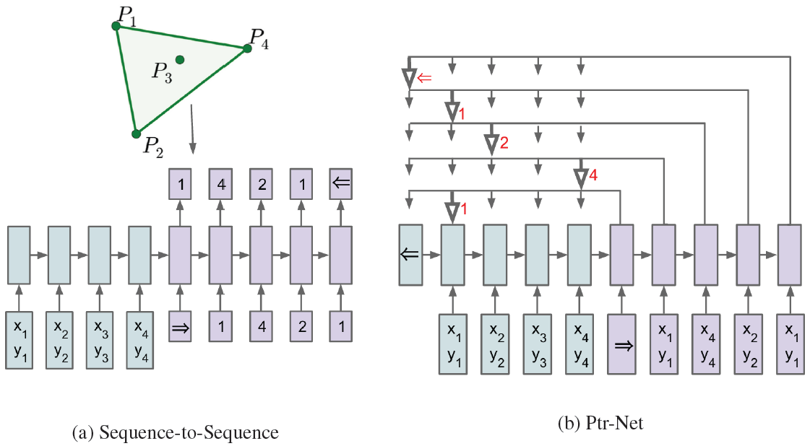
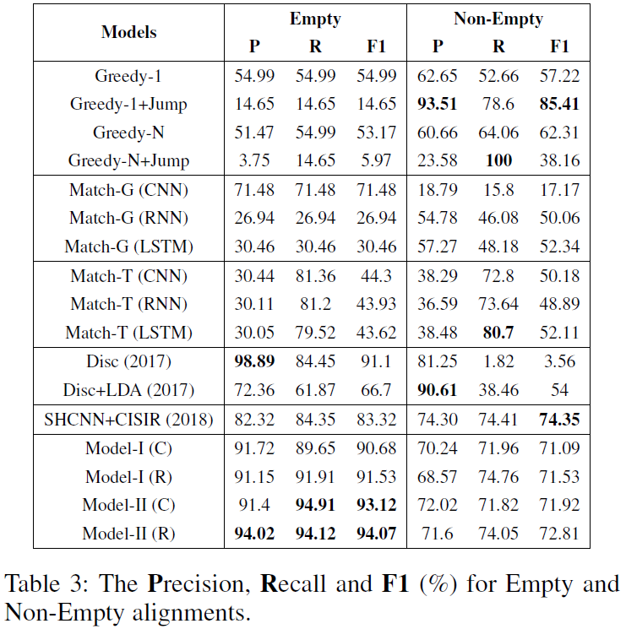
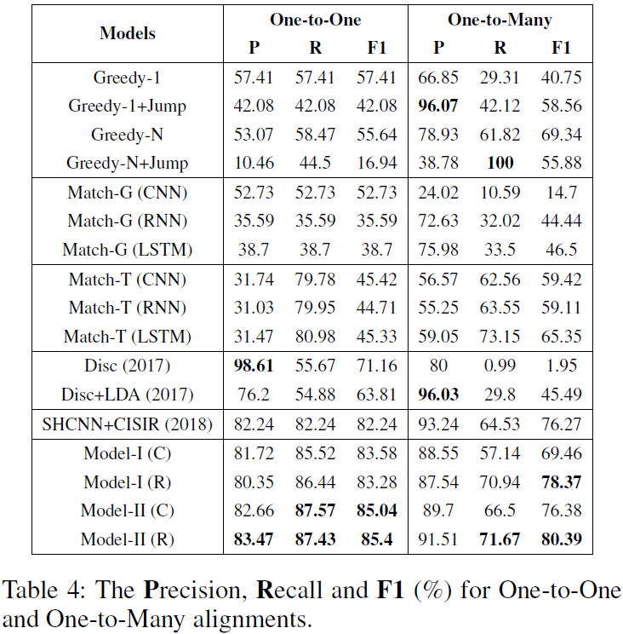


Learning to Align Question and Answer Utterances in Customer Service
Conversation with Recurrent Pointer Networks
Shizhu He¹, Kang Liu¹, Weiting An²
¹NLPR, Institute of Automation, Chinese Academy of Sciences; ²Alibaba Group
Task Description
Approach
Customer Service Conversation :
Customers ask questions;
Customer service staffs reply answers;
Multi-round conversation between two participants;
No explicit alignment marks among those utterances.
Utterance Alignment in Customer Service Conversation
Main architectures of Recurrent Pointer Networks (RPN) for Utterance Alignment
Model-I
Model-II
Motivation
The meaning of an utterance is context dependent.
The alignments of different utterances are correlating and interactional with each other.
There are various alignments of Q-A utterances in a CS conversation.
Alignment Decoder
Classification:
Regression:
Loss Function
Classification Loss
Regression Loss
$$p_{i,j}=sigmoid(a_{i,j})$$
Contributions
The task of obtaining the alignments of question and answer utterances in a CS conversation is very useful for CS conversation analysis and building intelligent dialogue systems.
We propose end-to-end models to learning the alignments of question and answer utterances in conversations with recurrent pointer networks.
The experimental results demonstrate that the proposed models are effective to obtain Q-A alignments, even for the utterances with None and One-to-Many alignments.
Experiments & Results
Experimental Results
None & One-to-Many
Background: Pointer Networks
National Laboratory of Pattern Recognition, Institute of Automation, Chinese Academy of Science
Notes:
20” x 28” approximate display area
For advice on designing posters, see:
http://www.swarthmore.edu/NatSci/cpurrin1/posteradvice.htm
http://www.aspb.org/education/poster.cfm
http://www.kumc.edu/SAH/OTEd/jradel/Poster_Presentations/110.html
http://ib.berkeley.edu/posters/printing/design.type.html

